Slide 1
3. single function

Slide 2
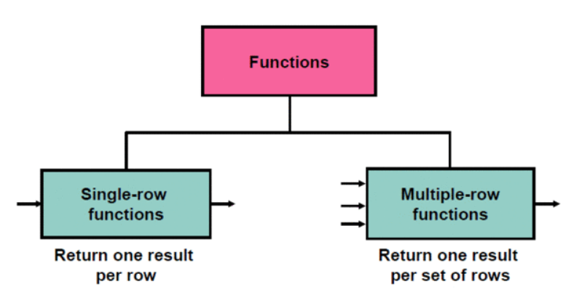
함수 종류
단일행 함수는 select, where, order by 절에 쓴다.

Slide 3



문자 함수 - 대소문자 변환 함수
select lower('SQL Course')
from dual;
select upper('SQL Course')
from dual;
select initcap('SQL Course')
from dual;

Slide 4


대소문자 변환 함수
select employee_id, last_name, department_id
from employees
where last_name='higgins';
select employee_id, last_name, department_id
from employees
where lower(last_name)='higgins';

Slide 5







문자 편집 함수
select concat('Hello','World') from dual;
select substr('HelloWorld',1,5) from dual;
select length('HelloWorld') from dual;
select instr('HelloWorld','W') from dual;
select lpad(salary,10,'*') from employees;
select rpad(salary,10,'*') from employees;
select replace('JACK and JUE','J','BL') from dual;

Slide 6



문자 편집 함수
select trim('H' from 'HelloWorld')
from dual;
select '|' || ' hello world ' || '|'
from dual;
select '|' || trim(' ' from ' hello world ') || '|'
from dual;

Slide 7

문자 편집 함수
select employee_id, concat(first_name, last_name) name,
job_id, length(last_name), instr(last_name, 'a') "Contains 'a'?"
from employees
where substr(job_id,4)='REP';
select employee_id, concat(first_name, last_name) name,
length(last_name), instr(last_name,'a') "Contains 'a'?"
from employees
where substr(last_name,-1,1)='n';

Slide 8



숫자 함수
select round(45.926,2)
from dual;
select trunc(45.926,2)
from dual;
select mod(1600,300)
from dual;

Slide 9



숫자 함수
select round(45.923,2), round(45.923,0), round(45.923,-1)
from dual;
select trunc(45.923,2), trunc(45.923), trunc(45.923,-1)
from dual;
select last_name, salary, mod(salary,5000)
from employees
where job_id='SA_REP';

Slide 10




날짜 산술식
select sysdate from dual;
select sysdate+1 from dual;
select sysdate-1 from dual;
select sysdate-sysdate from dual;
select sysdate+sysdate from dual; --error
select sysdate*1 from dual; --error
select sysdate/1 from dual; --error

Slide 11
날짜 산술식
select last_name, (sysdate-hire_date)/7 as weeks
from employees
where department_id=90;

Slide 12



날짜 함수
select months_between('25-FEB-19','19-DEC-18') from dual;
select months_between('19-DEC-18','25-FEB-19') from dual;
select add_months('19-DEC-18',1) from dual;
select next_day('18-DEC-18','friday') from dual;
select last_day('18-DEC-18') from dual;

Slide 13
날짜 함수
select employee_id, hire_date,
months_between(sysdate,hire_date) tenure,
add_months(hire_date, 6) review,
next_day(hire_date, 'friday'),
last_day(hire_date)
from employees
where months_between(sysdate, hire_date)<150;

Slide 14






round와 날짜
select round(to_date('14-feb-23'),'month') from dual;
select round(to_date('15-jan-23'),'month') from dual;
select round(to_date('16-jan-23'),'month') from dual;
select round(to_date('01-jan-23'),'year') from dual;
select round(to_date('30-jun-23'),'year') from dual;
select round(to_date('01-jul-23'),'year') from dual;

Slide 15






trunc와 날짜
select trunc(to_date('14-feb-23'),'month') from dual;
select trunc(to_date('15-jan-23'),'month') from dual;
select trunc(to_date('16-jan-23'),'month') from dual;
select trunc(to_date('01-jan-23'),'year') from dual;
select trunc(to_date('30-jun-23'),'year') from dual;
select trunc(to_date('01-jul-23'),'year') from dual;

Slide 16
날짜
select employee_id, hire_date,
round(hire_date, 'month'),
trunc(hire_date, 'month')
from employees
where hire_date like '%07';

